Slide 1
ToDo
Fuzzing Rust Programs
Check whether fuzzers can find memory safety bugs
in an unsafe crates
in Most Download crates
Try afl.rs for stand-alone programs
Does fuzzers detects memory safety bugs that RUDRA cannot detect?
Compare bugs that fuzzers found and RUDRA found

Slide 2
Find Memory Safety Bugs in Rust Programs using Fuzzers
Target program and Fuzzing configuration
Initial Attempt and Results
Revised Fuzzing configuration
Fuzzing results

Slide 3
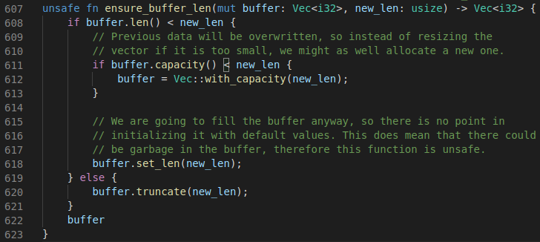
Target Programs
Claxon v0.4.1
FLAC decoder written in pure Rust
The version containing a memory safety bug (uninitialized read)
using afl with libdiffuzz (security-oriented alternative to Memory Sanitizer)
A function that induces uninitialized memory region in src/frame.rs of claxon crate

Slide 4
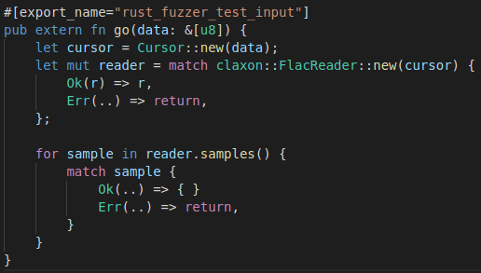
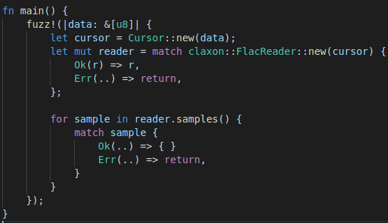
Fuzzing Configuration (Initial Attempt)
cargo-fuzz (libfuzzer)
with AddressSanitizer
More than 20 hours of fuzzing (more than 3 billion inputs)
Fuzz target and seed inputs provided by the crate
afl.rs (AFL++)
No sanitizer
Using claxon as a black-box library
More than 18 hours of fuzzing (more than 7 billion inputs)
Fuzz target and seed inputs provided by the crate
cargo-fuzz’s fuzzing target for claxon
afl.rs’ fuzzing target for claxon

Slide 5
Fuzzing Results (Initial Attempt)
No found crash for both cargo-fuzz and afl.rs
Results for cargo-fuzz
# inputs: 3,091,882,449
coverage: 2317 blocks
exec/s: 31,514
Results for afl.rs
# inputs: 7,344,333,757
coverage: 1953/7647
exec/s: 113,137
stability: 100%

Slide 6
Revise Fuzzing Configurations
To detect the uninitialized memory read!
Fuzzers can only detect crashes.
The uninitialized memory read may not induce a crash.
It is necessary to reveal the uninitialized memory read for fuzzers.
Use sanitizer!

Slide 7
Revised Fuzzing Configuration
afl.rs (AFL++)
Using libdiffuzz (security-oriented alternative to Memory Sanitizer)
Using claxon as 1) black-box library or 2) with source codes
Same fuzzing target and seed inputs
Run a program twice with different initialization value
Allocate memory
(p=malloc(sizeof(int)*6))
Use the allocated memory region
(p[0]=4; p[1]=5;)
Use uninitialized memory somewhere
(result = p[3])
1st run
p:
1 | 1 | 1 | 1 | 1 | 1
p:
4 | 5 | 1 | 1 | 1 | 1
result_1st == 1
2nd run
p:
2 | 2 | 2 | 2 | 2 | 2
p:
4 | 5 | 2 | 2 | 2 | 2
result_2nd == 2
Initialize allocated memory with 1 in the 1st run while 2 in the 2nd run
The differ results, a detected uninitialized memory read
An example to show how libdiffuzz finds uninitialized memory read

Slide 8
Fuzzing Results
No found crash for both afl.rs.1 and afl.rs.2
Results for afl.rs.1
More than 21 hours
# inputs: 6,042,425,693
coverage: 1955/7647
exec/s: 79,026
stability: 100%
Results for afl.rs.2
More than 17 hours
# inputs: 4,048,254,456
coverage: 1914/7717
exec/s: 66,073
stability: 100%

Slide 9
Discussion
How to improve fuzzing to detect the bug?
More valuable fuzz target
MemorySanitizer
Not yet found any reason why afl.rs (and its examples) does not use file inputs

Slide 10
Next ToDo
Fuzzing Rust Programs
Check whether fuzzers can find memory safety bugs
in claxon with MemorySanitizer
in Most Download crates
Try afl.rs for stand-alone programs
Does fuzzers detects memory safety bugs that RUDRA cannot detect?
Compare bugs that fuzzers found and RUDRA found

